Slide 1
How to publish your paper in a Scopus indexed Journal
Dr.Kevalin Setthakorn
Experience
SHARING

Slide 2
Setthakorn, K.P. (2020).The study of job embeddedness and its effect on employee retention in the hospitality industry of Pattaya city, Chonburi province. Pertanika Journal of Social Sciences & Humanities. 28(3). 1819-1833.
My Achievement:
Received: 12 August 2019
Accepted: 24 January 2020
Published: 25 September 2020

Slide 3
Steps in publishing your paper in a Scopus indexed journal
Discovering Scopus Indexed Journals
Identifying the best Journal that suit your paper
Compose your paper as per the guidelines of the journal
English proofread certificate (for ESL author)
Submitting the paper (pay the submission fee)
Revise the paper according to reviewers’comments
Acceptance from the publisher

Slide 4
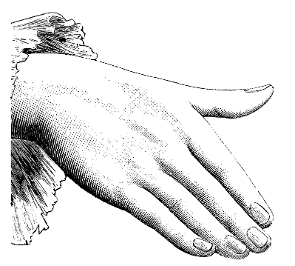
Large image slide
https://www.scopus.com/sources

Slide 5
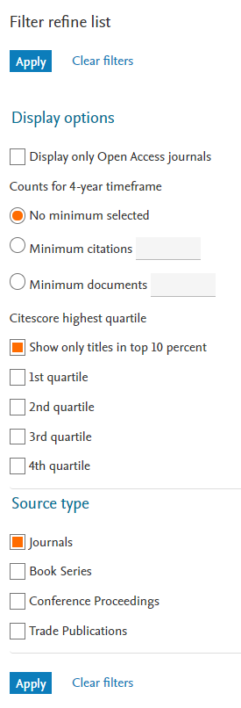
Identifying the best Journal that suit your paper/interest
Ranking
Literature Review
Look at journal’s interest
Similar methodology
Publication Time Frame
Scopus Ranking: Q1 – Q4

Slide 6
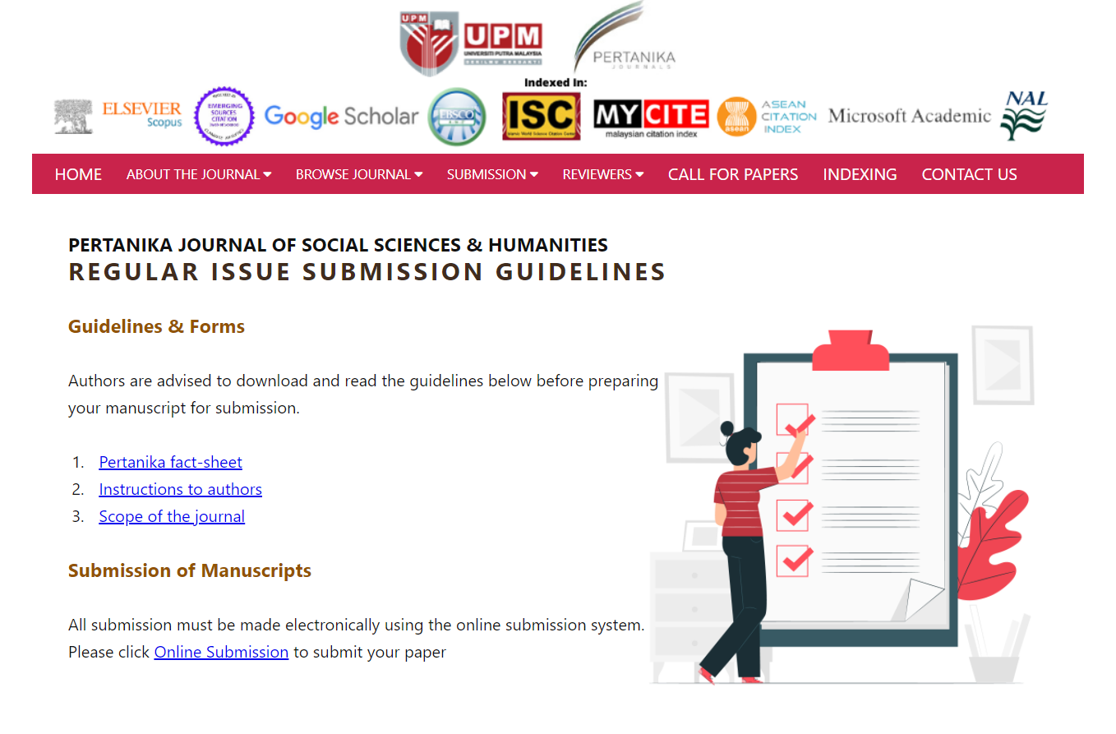
Word Count, Font, Paragraph Spacing, Table & Graph Format, Reference Style

Slide 7
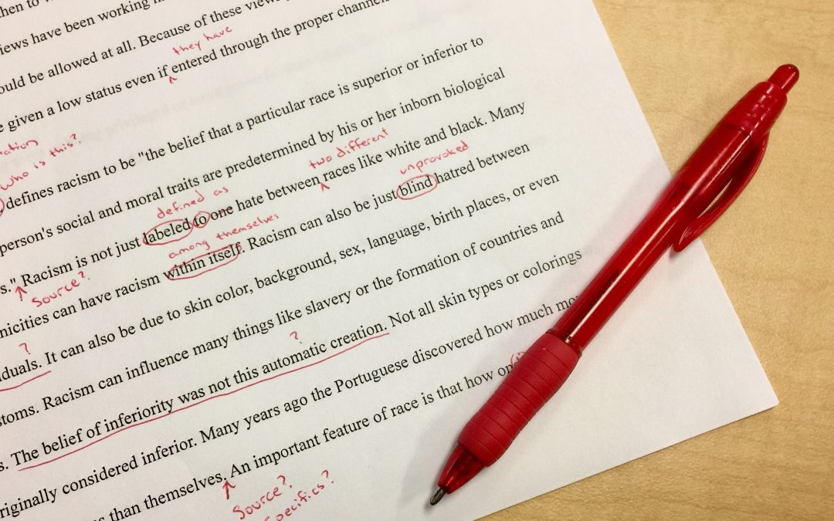
English Proofread Certificate
Often require by publisher for English as a Second Language author
I used ‘Proof-Reading-Service.com’
£14.00 per thousand words or 1.4 pence per word. Approx. 600 Bahts per thousand words
Fast & Reliable
RU – Ramkhamhaeng Institute of Language also have proof reading services
Affordable Price
Long queue

Slide 8
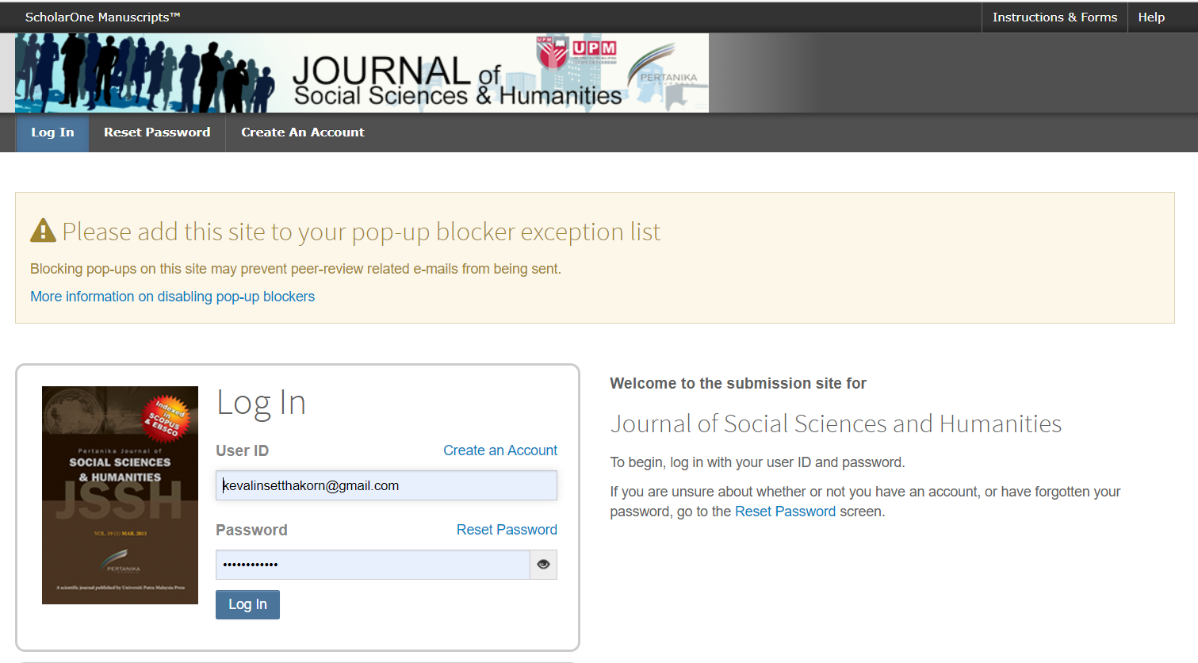
Submitting the Paper to the Journal
Pertanika Journal of Social Science & Humanities
Done through ScholarOne
Popular Online Manuscripts Support Website

Slide 9
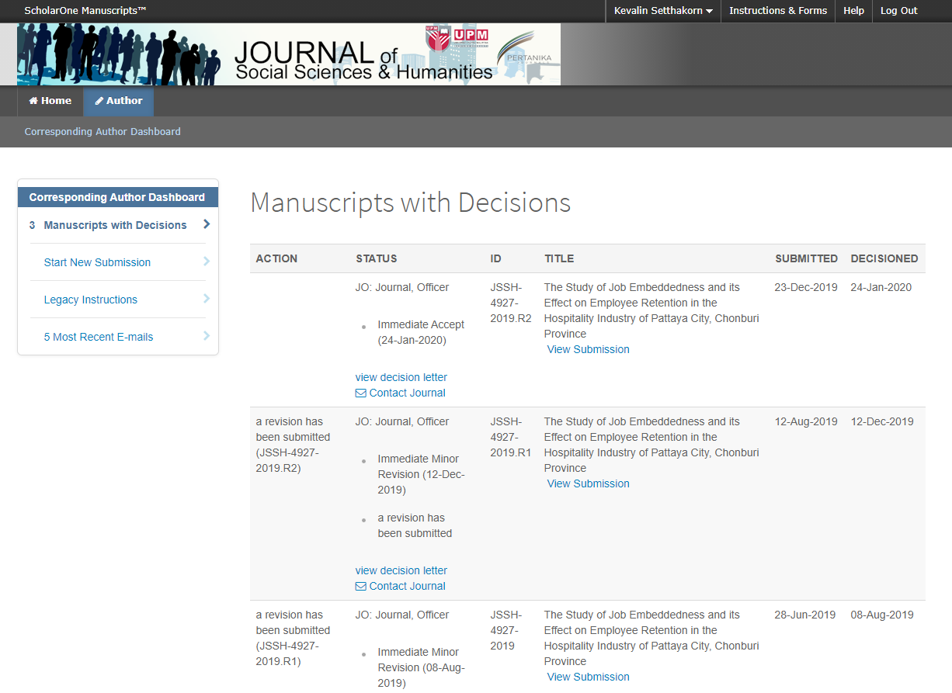
Revise the paper according to reviewers’comments

Slide 10
THANK YOU
Your manuscript has been accepted for publication
Experience
SHARING
How to publish your paper in a Scopus indexed Journal

